Slide 1


Slide 2
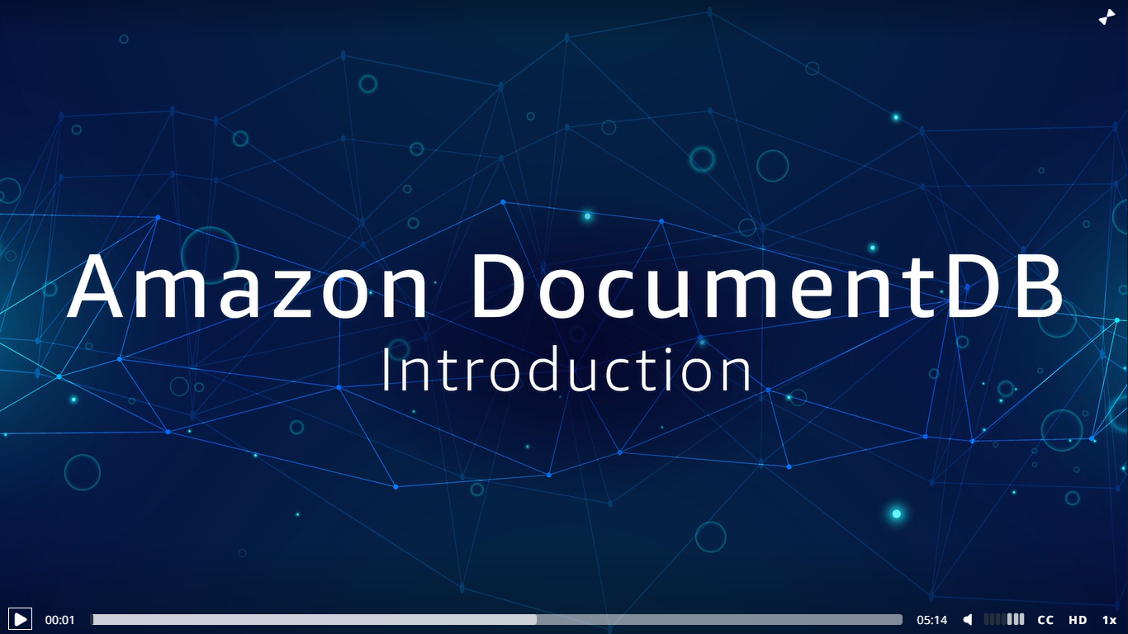

Slide 3



Amazon DocumentDB
FAST, SCALABLE AND FULLY MANAGED MONGODB COMPATIBLE DATABASE SERVICE
Fast and scalable
Scale compute in minutes
Storage and I/O autoscaling
Storage scale to 64 GB
15 replica for millions of read
Globally distributed
Fully Managed
Built-in high availability
Backups enable by default
Durable by default
Security best practice by default
Automatic patching
Monitoring and alerting
MongoDB compatible
Application , drivers, tool can be used with little or no change
Support hundreds of APIs, operator and stages
Continually working backward from customer to deliver the capabilities they need.

Slide 4




When should you use a document database ?
{ }
JSON
Data
Flexible schema for fast iteration
Add hoc query
capabilities
Flexible
Indexing
Operational and analytics workloads

Slide 5
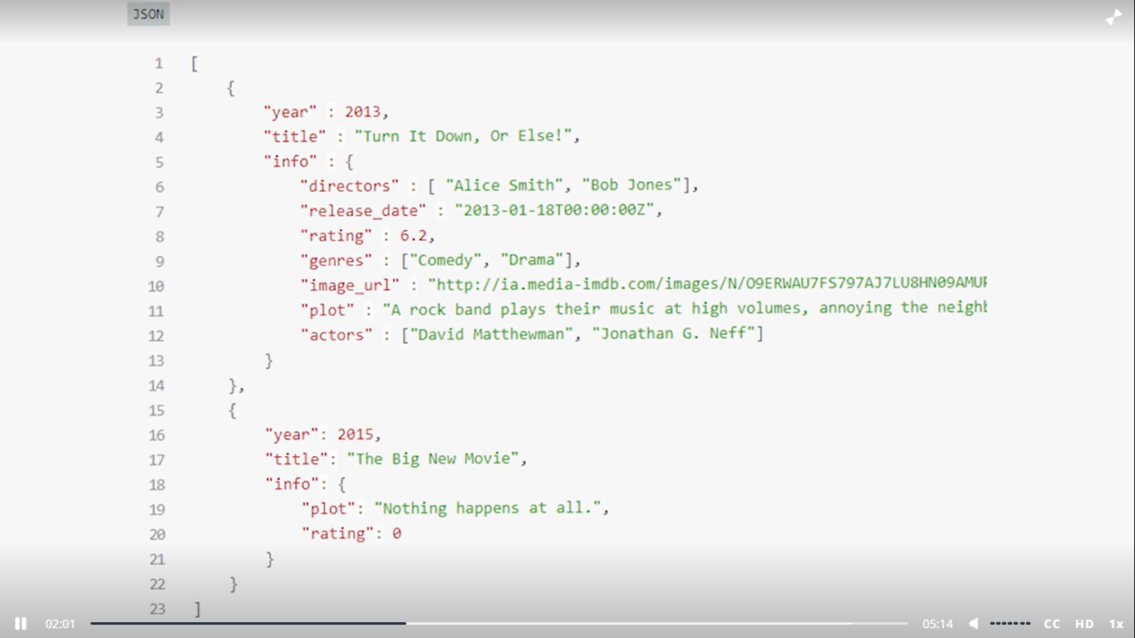

Slide 6
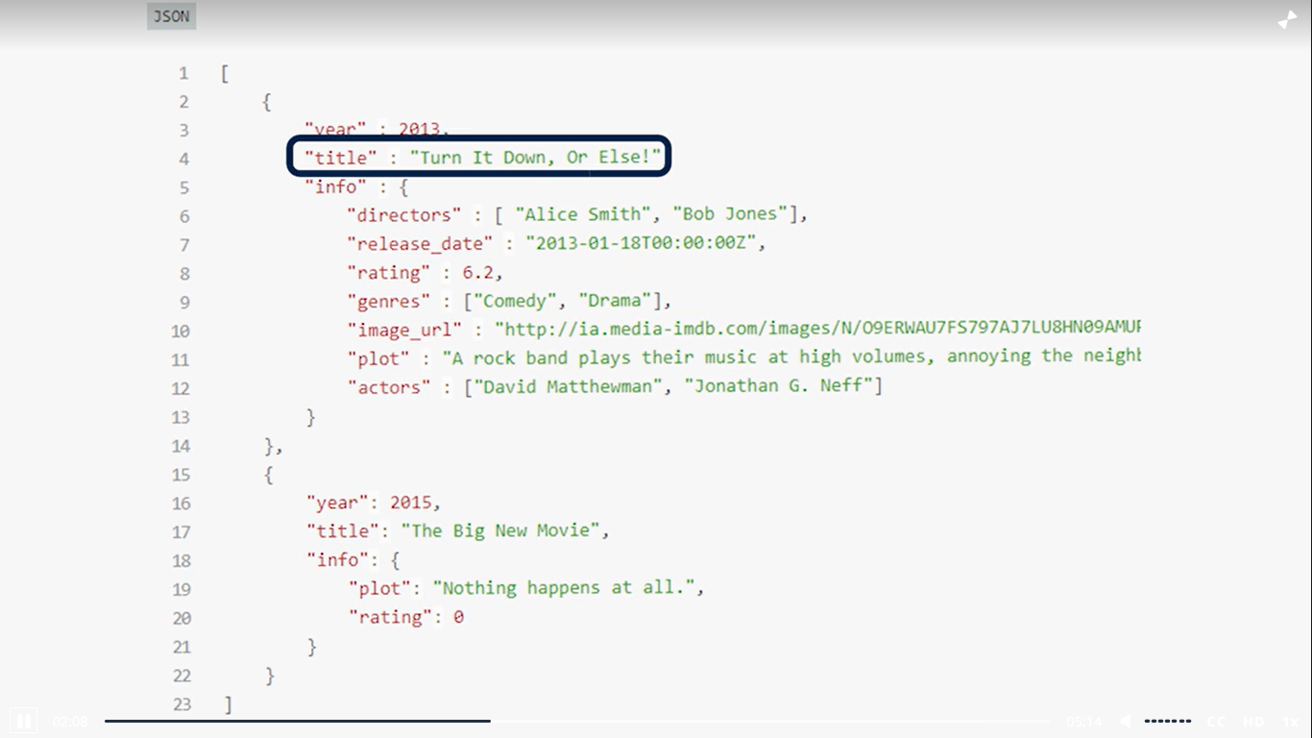

Slide 7
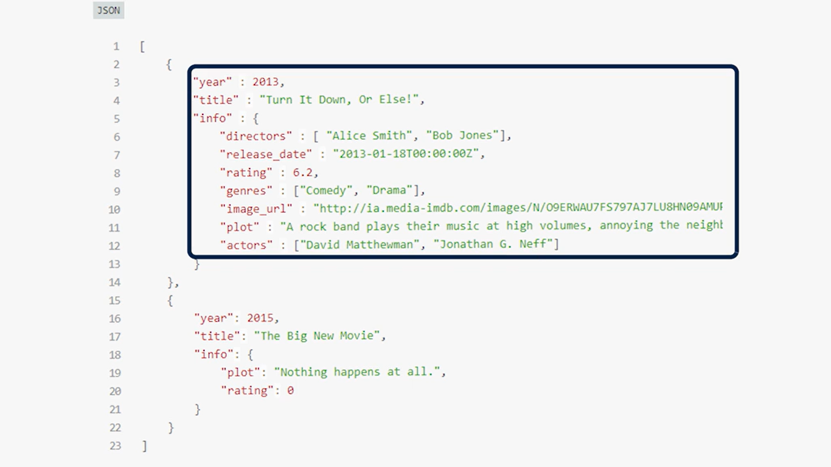

Slide 8
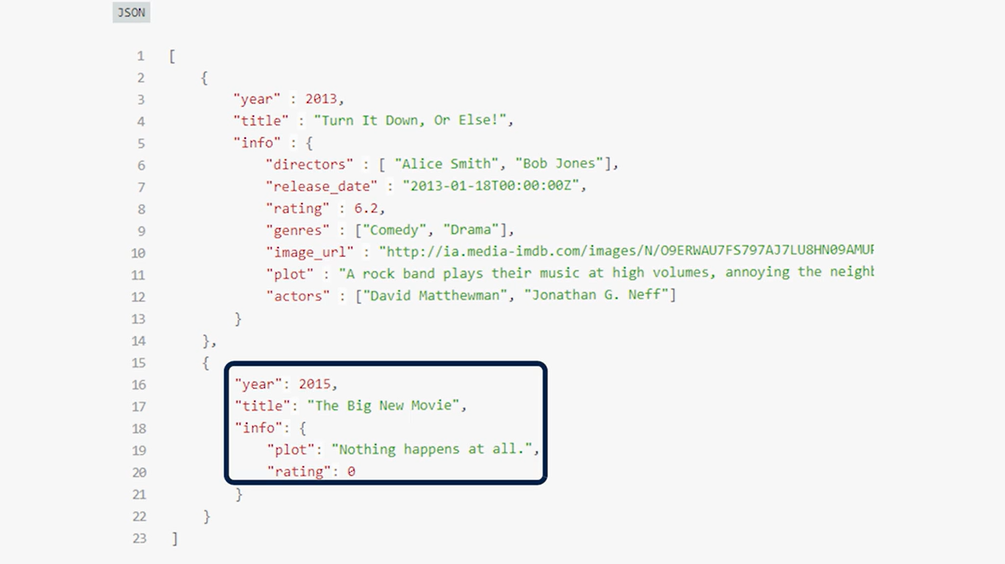

Slide 9
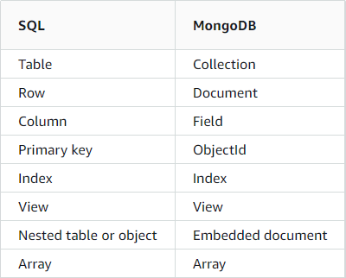
SQL vs. Nonrelational Terminology

Slide 10
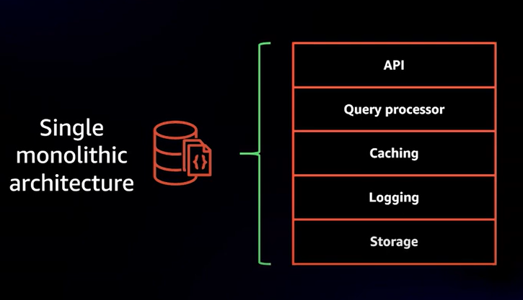
Architecture
TRADTIONAL DATABASE ARCHITECTURE

Slide 11
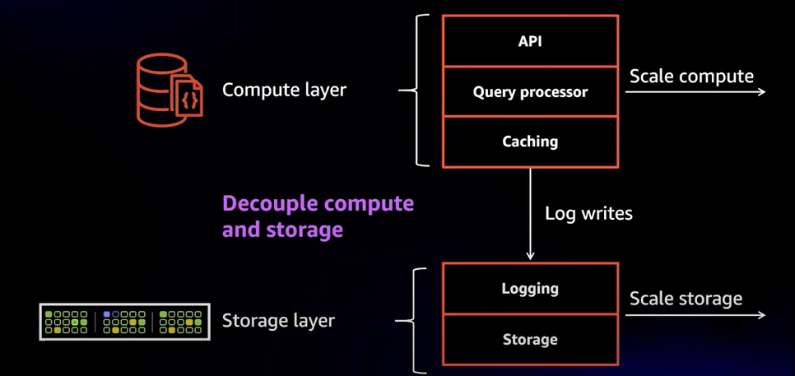
Architecture
SEPETATION OF STORAGE AND COMPUTE

Slide 12
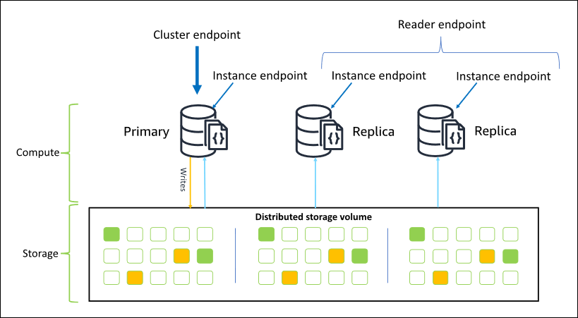
Architecture

Slide 13
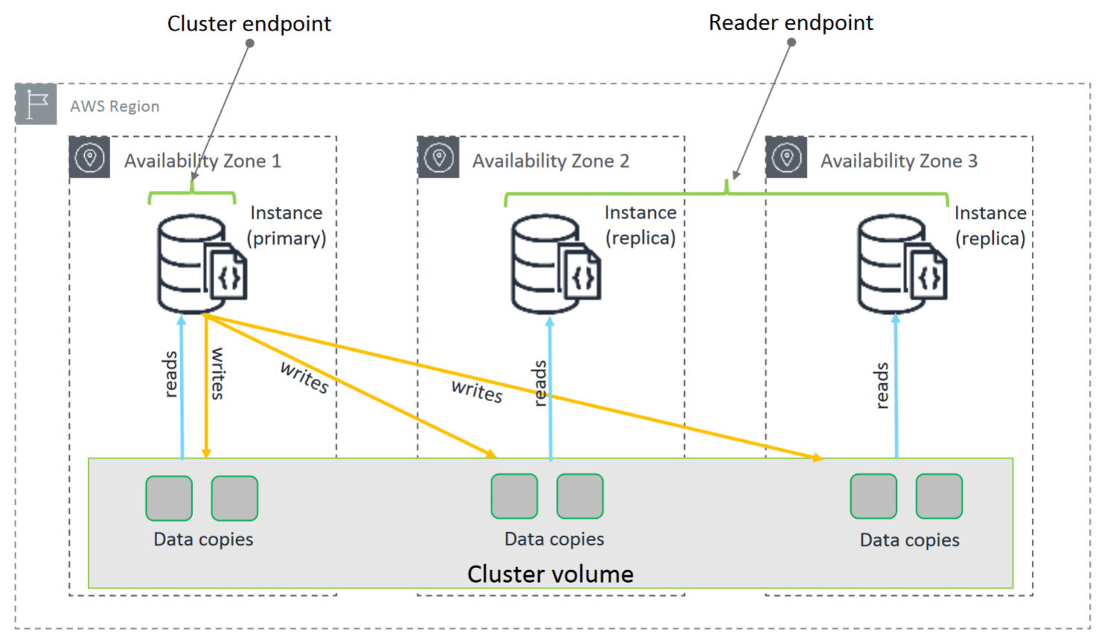

Slide 14
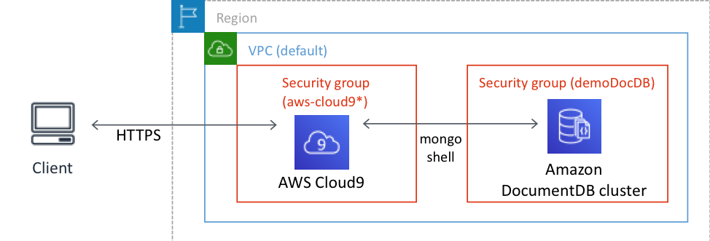

Slide 15
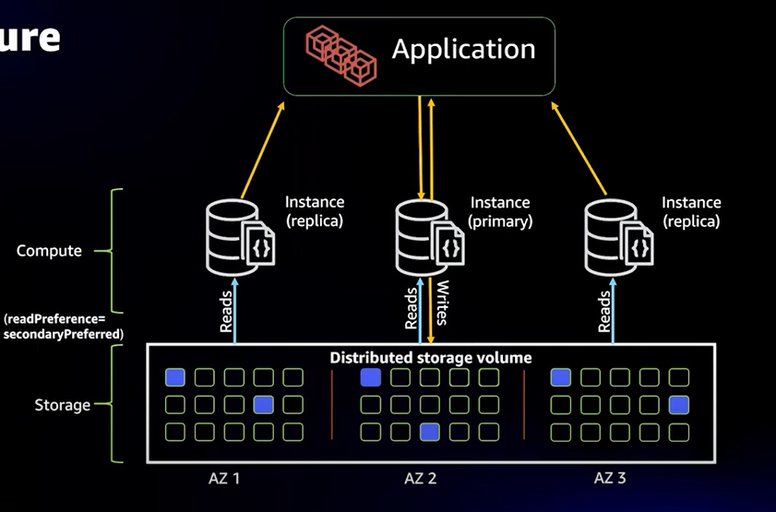
Architecture
REPLICATION

Slide 16
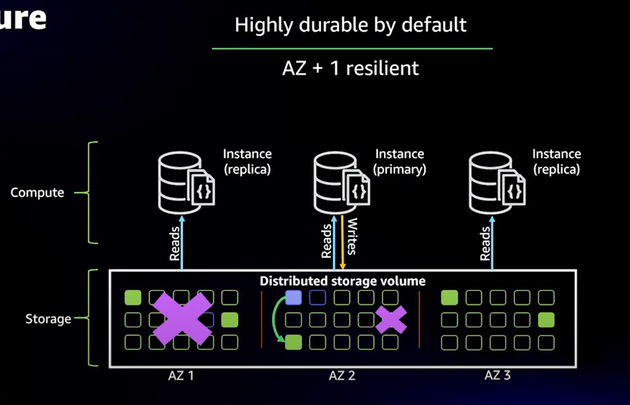
Architecture
DURABILITY

Slide 17
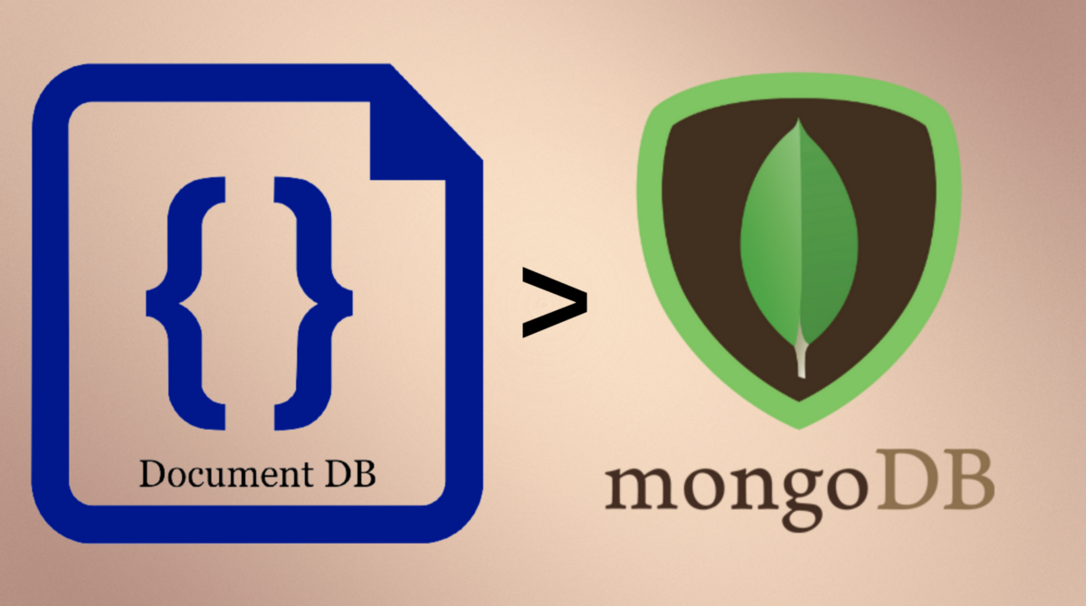

Slide 18
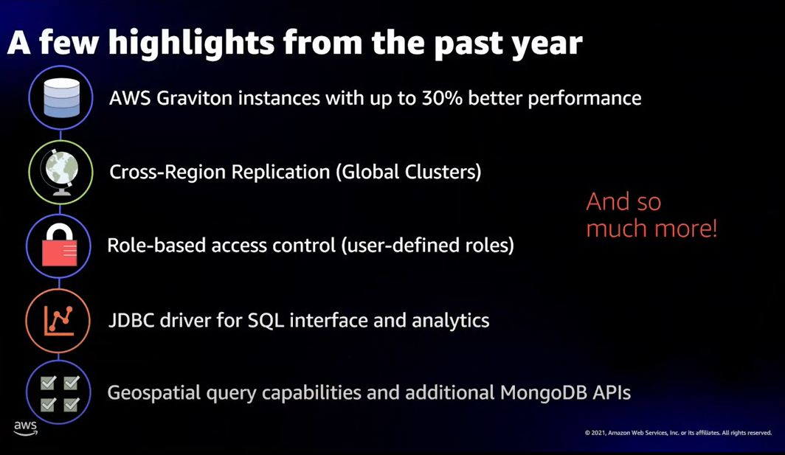

Slide 19
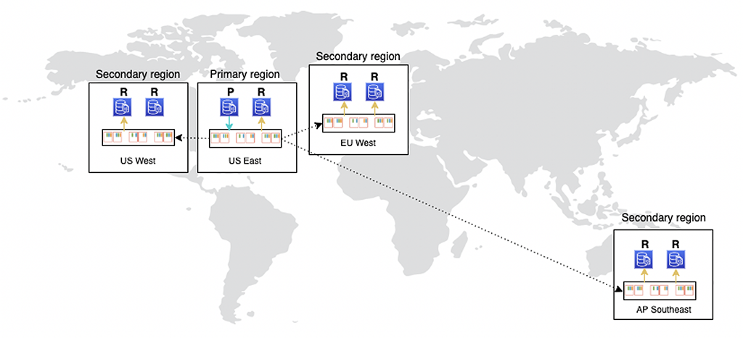
Global cluster

Slide 20


Amazon DocumentDB Pricing
Instance hours (per hour)
I/O requests (per 1 million requests per month)
Backup storage (per GiB per month)
Data transfer (per GB)

Slide 21
Some hands ON

